Slide 1

LSR Order process flow/data flow

Slide 2
Trading Partner Request Types
Preorder
  Address Validation
  CSR Retrieval
  Loop Qualification
LSR Order
SOA
Portability
  Wireless to Wireless
  Wireline to Wireless

Slide 3
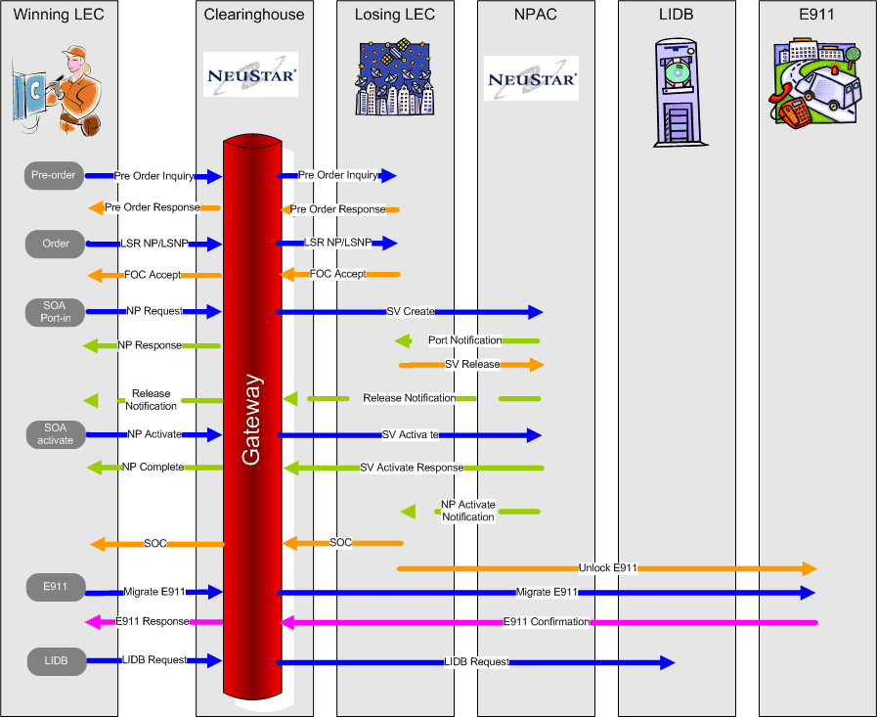
Basic Order Process Flow (LSNP/NP)

Slide 4
Type of Responses
FOC – Order Entry Response indicating that firm order is complete.
SOC – Order Entry Response indicating that service order is complete.
ACK – Order Entry Response indicating that the order is accepted.
NACK – Order Entry Response indicating problem with accepting the order.
FOCREJECT - Order Status Response indicating that the order cannot be fulfilled.

Slide 5
LSR
Local Service Request
  Used to order local loops and features
  Common types of requests are Number port
  Can be used to order more than one line in a transaction
  EDI over Interactive agent is mostly used to transmit LSR orders to ILEC

Slide 6
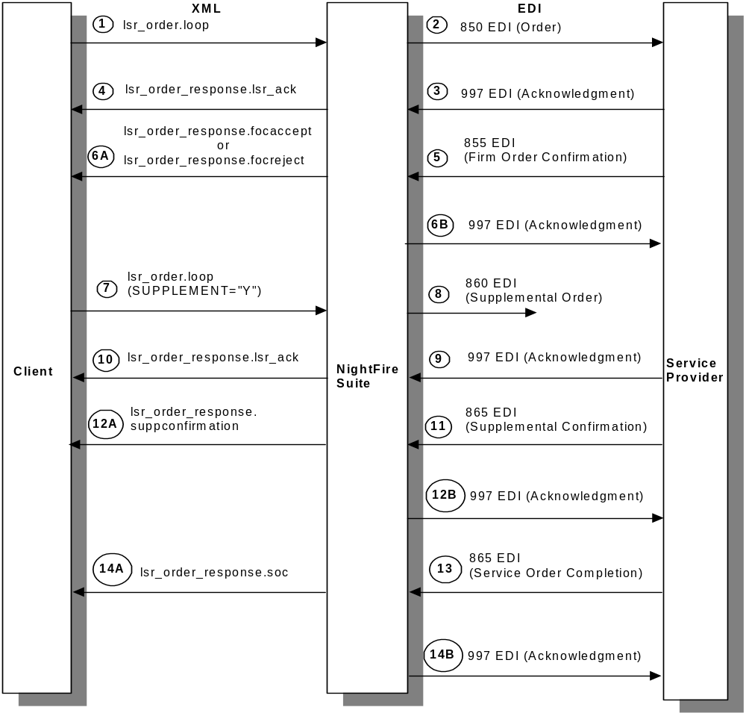
LSR flow

Slide 7

Neustar Configuration Overview
NPAC Databases
ALI Databases
CNAM/ LIDB Databases
LIDB Admin.
E911 Admin.
NPAC
CNAM Updates
LIDB Updates
Wireline E911
SOA Updates
Neustar Clearinghouse
FOC
LSR
DL
LSR Suppliers
LSR
Directory Listing
CNAM/ LIDB
E911
SOA Activate
Switch Provisioning Activities
Customer Service Activation
CSR
Network Translation
Engineers
Upstream systems

Slide 8
LSR – Business Work Flow
Initial
Save
Got
NACK
Started
FOC
Non-fatal
reject
Got
Non-Fatal
FOC
Submit
NACK
Send
Send
Waiting-
For ACK
FOC
Non-fatal
reject
FOC
Unexpected Message
FOC
ACK
Waiting-
For FOC
Note: Transitions
can be caused
implicitly by event
receipt or explicitly
driven by workflow
FOC
fatal
reject
FOC
Send
Waiting-
For SOC
any
FOC
fatal
reject
Unexpected Message
SOC
Got
Fatal
FOC
Done
Unexpected Message

Slide 9
LSR Database Logging
For loop orders, there are three tables that are logged to with each transaction:
  LSR_MESSAGE
  TRANSACTION_SET
  EDI_MESSAGE

Slide 10
LSR Database Logging (cont.)
LSR_MESSAGE
Contains the PON, version, ILEC, Datetime, transaction type, and XML message for every inbound/outbound request/response sent/received.

Slide 11
LSR Database Logging (cont.)
LSR_MESSAGE
Table used by LSR GUI to lookup existing orders and responses.
Not indexed by default.
Contains records only if mapping was successful.
No key or unique ID

Slide 12
LSR Database Logging (cont.)
TRANSACTION_SET
Contains the message_key, ILEC, PON, version, transaction type number, datetime, direction, and message control numbers.
Used to record each specific transaction and break apart batches in EDI.

Slide 13
LSR Database Logging (cont.)
TRANSACTION_SET
Unique ID is message_key taken from a message key sequence in Oracle, though message_key may repeat in table.
Can be linked to LSR_MESSAGE using PON, ILEC, and version.

Slide 14
LSR Database Logging (cont.)
EDI_MESSAGE
Records the message_key, ILEC, datetime, and EDI message sent or received.
Each record may refer to multiple transactions due to batched EDI.
Unique ID is message_key and does not repeat in table.

Slide 15
LSR Database Logging (cont.)
EDI_MESSAGE
Can be linked to TRANSACTION_SET via message_key.
Can only be linked to LSR_MESSAGE via TRANSACTION_SET.

Slide 16
LSR Database Logging (cont.)
LSR_MESSAGE
ILEC
DATETIME
PON
VER
TYPE
LSRNO
MESSAGE
TRANSACTION_SET
MESSAGE_KEY
ILEC
DATETIME
PON
VER
TRANSACTION
DIRECTION
INTERCHANGE_CTRL
FUNC_GROUP_CTRL
TRANS_SET_CTRL
EDI_MESSAGE
MESSAGE_KEY
ILEC
DATETIME
MESSAGE

Slide 17
LSR Order Request Data Flow
LSR Order Submit
No – with error message
Delivered successfully to
gateway
Submit
SPI G/W validation
Yes
LSR_MESSAGE
Consists request xml
EDILSR_MESSAGE_Q
Consists request edi
IA
Success
IA Client sends to ILEC
Failure
Yes
EDILSR_MESSAGE_Q
If Failure < 10
Tries for repeat 10 times
No
Not Processing

Slide 18
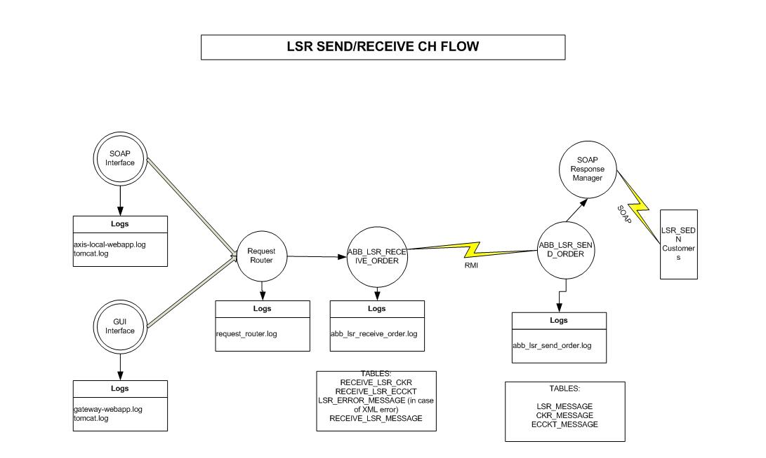
LSR_SEND_FLOW

Slide 19
LSR Order Response Data Flow
Delivers response via
IA
ILEC
Identify CID
Logs the message
RESPONE_MESSAGE
Parse Edi – converts
to XML
Updates the ERRORSTATUS
As ‘DELIVERED’
SPI G/W
Soap Response Manager – registers with all
Event channels for each g/w with CID
PERSISTENTEVENT
Updates the ERRORSTATUS
As ‘FAILURE’
Yes
If Delivers to CLEC
If Failure < 10
Success
Updates the STATUS
As ‘NOTPROCESSING’
RESPONSEMESSAGEQUEUE

Slide 20
